Slide 1
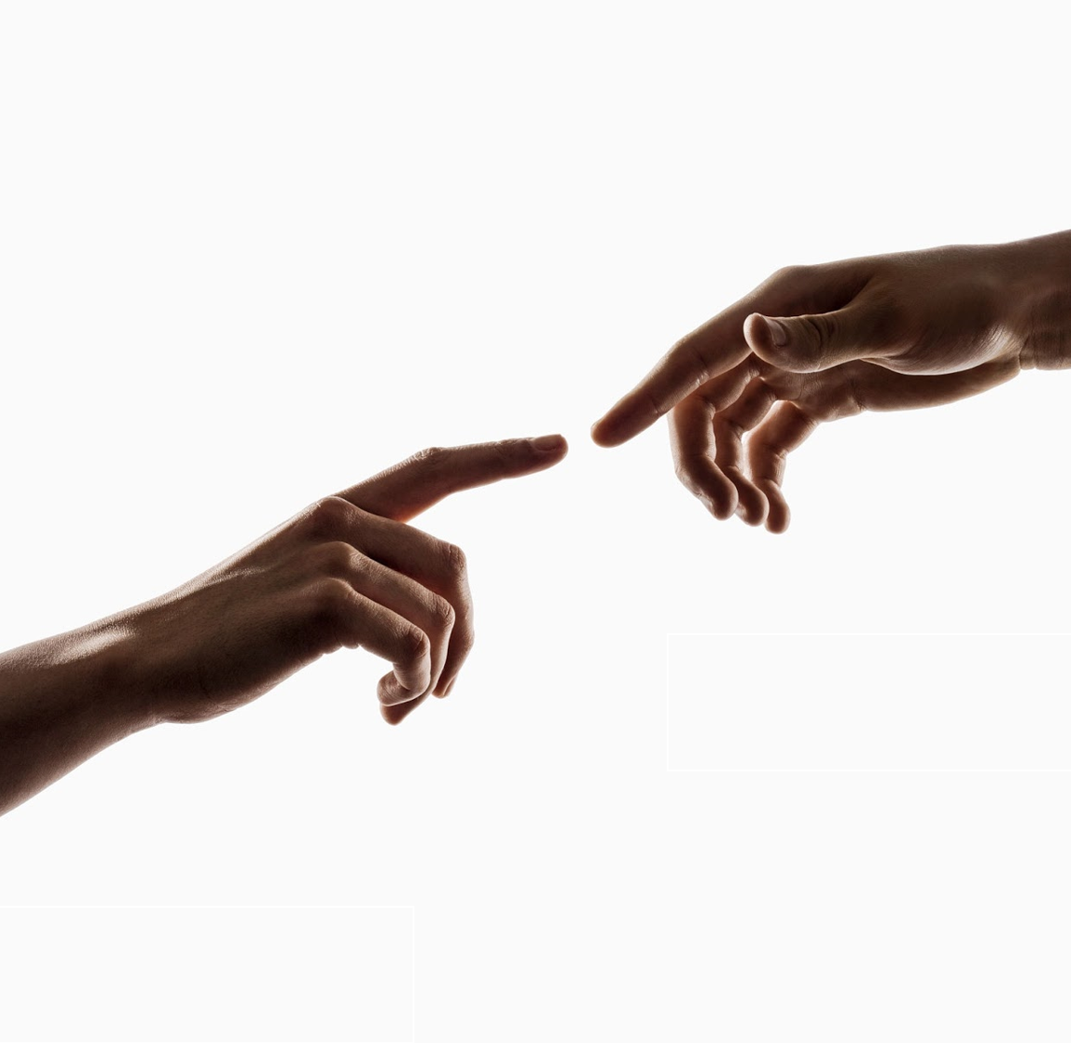
Power in your hand is unlimited
Group 4 Gesture Recognition
組長：黃奕誌
組員：張敏慧、吳松濤、王俊人、莊惠文、姜以萱、莊尤翔、趙蓉根

Slide 2
Have you ever thought about …

Slide 3

Our creativity might be hindered from peripheral around us

Slide 4

Like a painter They only need few handy tools to make huge heady works

Slide 5
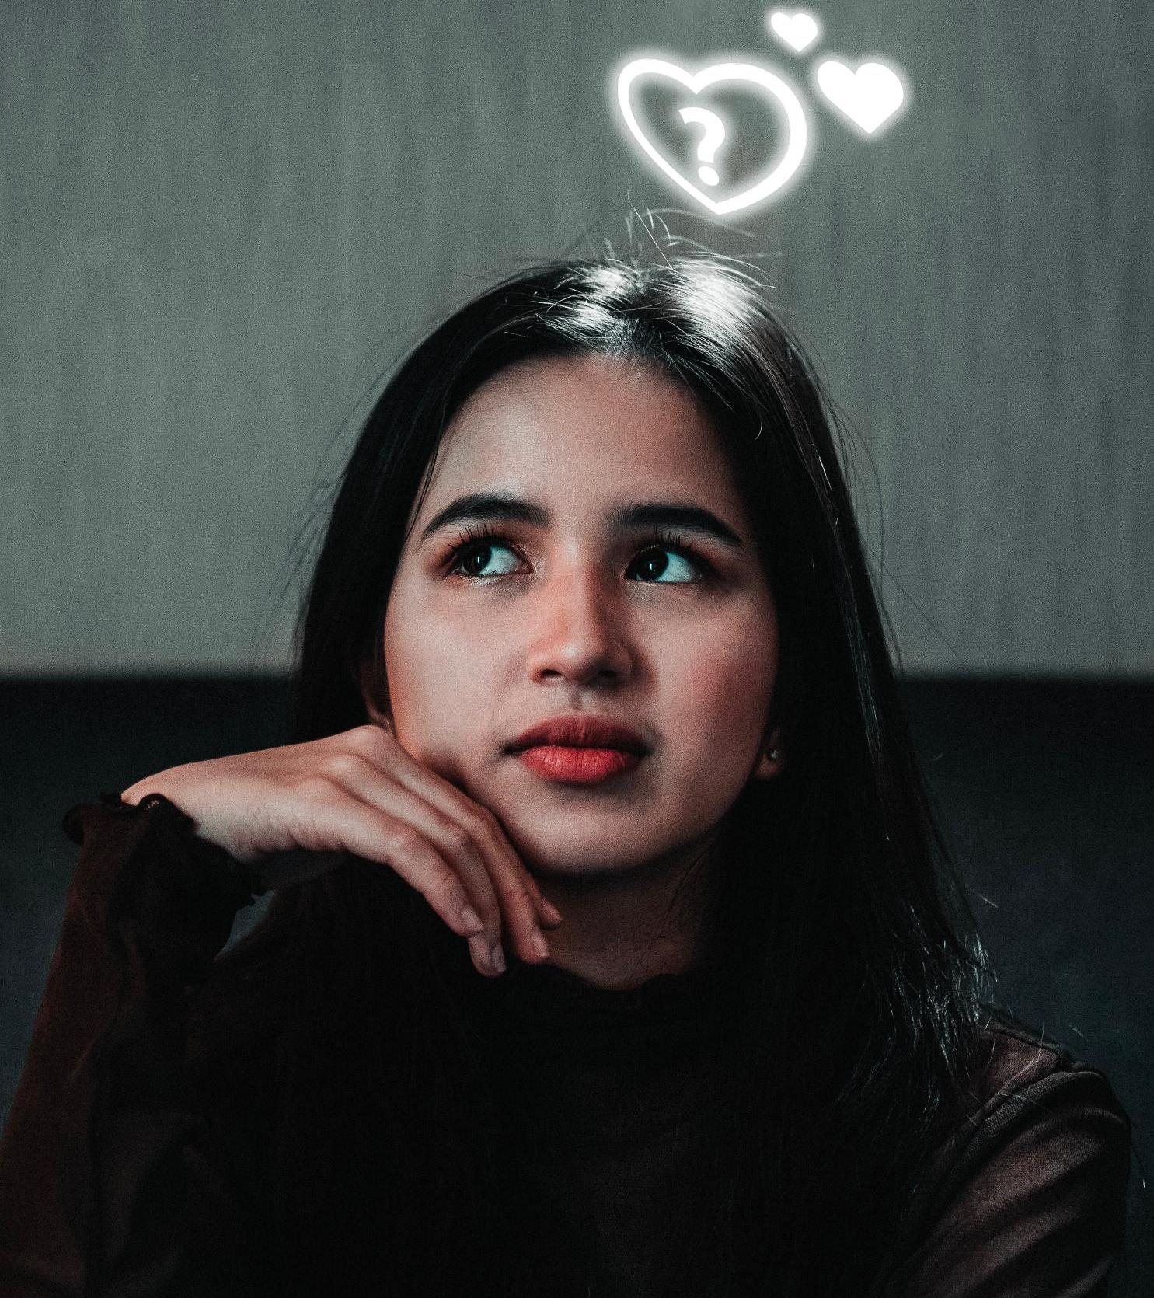

Do we really need this?

Slide 6

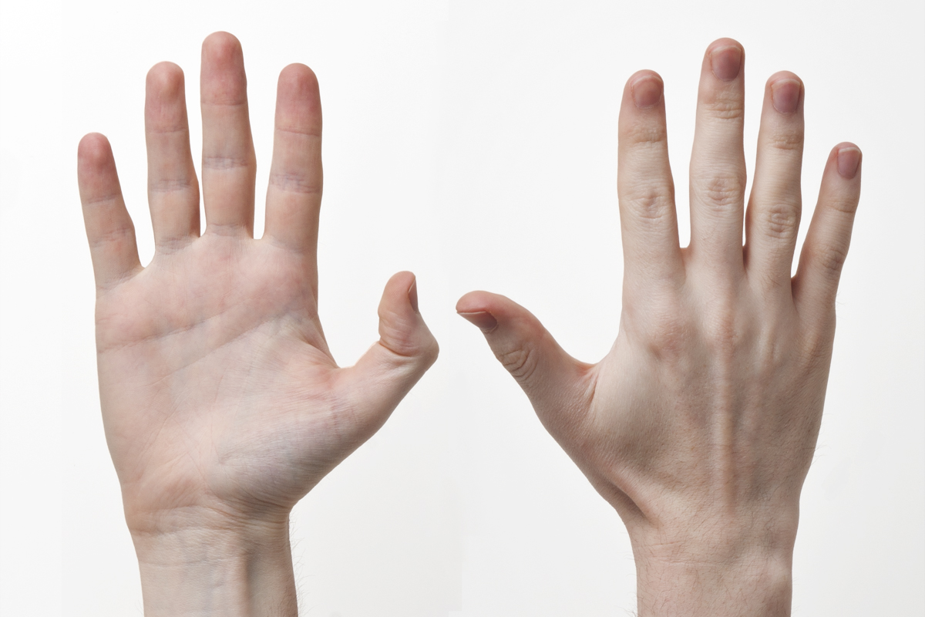
How about replacing partial PC function with bare hands

Slide 7

Operating a computer with hand gesture is no longer an imagination

Slide 8

What are we aiming at?
•AI model
•Gesture Recognition
•Operating System
•Gesture control mouse & keyboard
•3 modes: keyboard, mouse, sleep
•GUI monitor icon

Slide 9


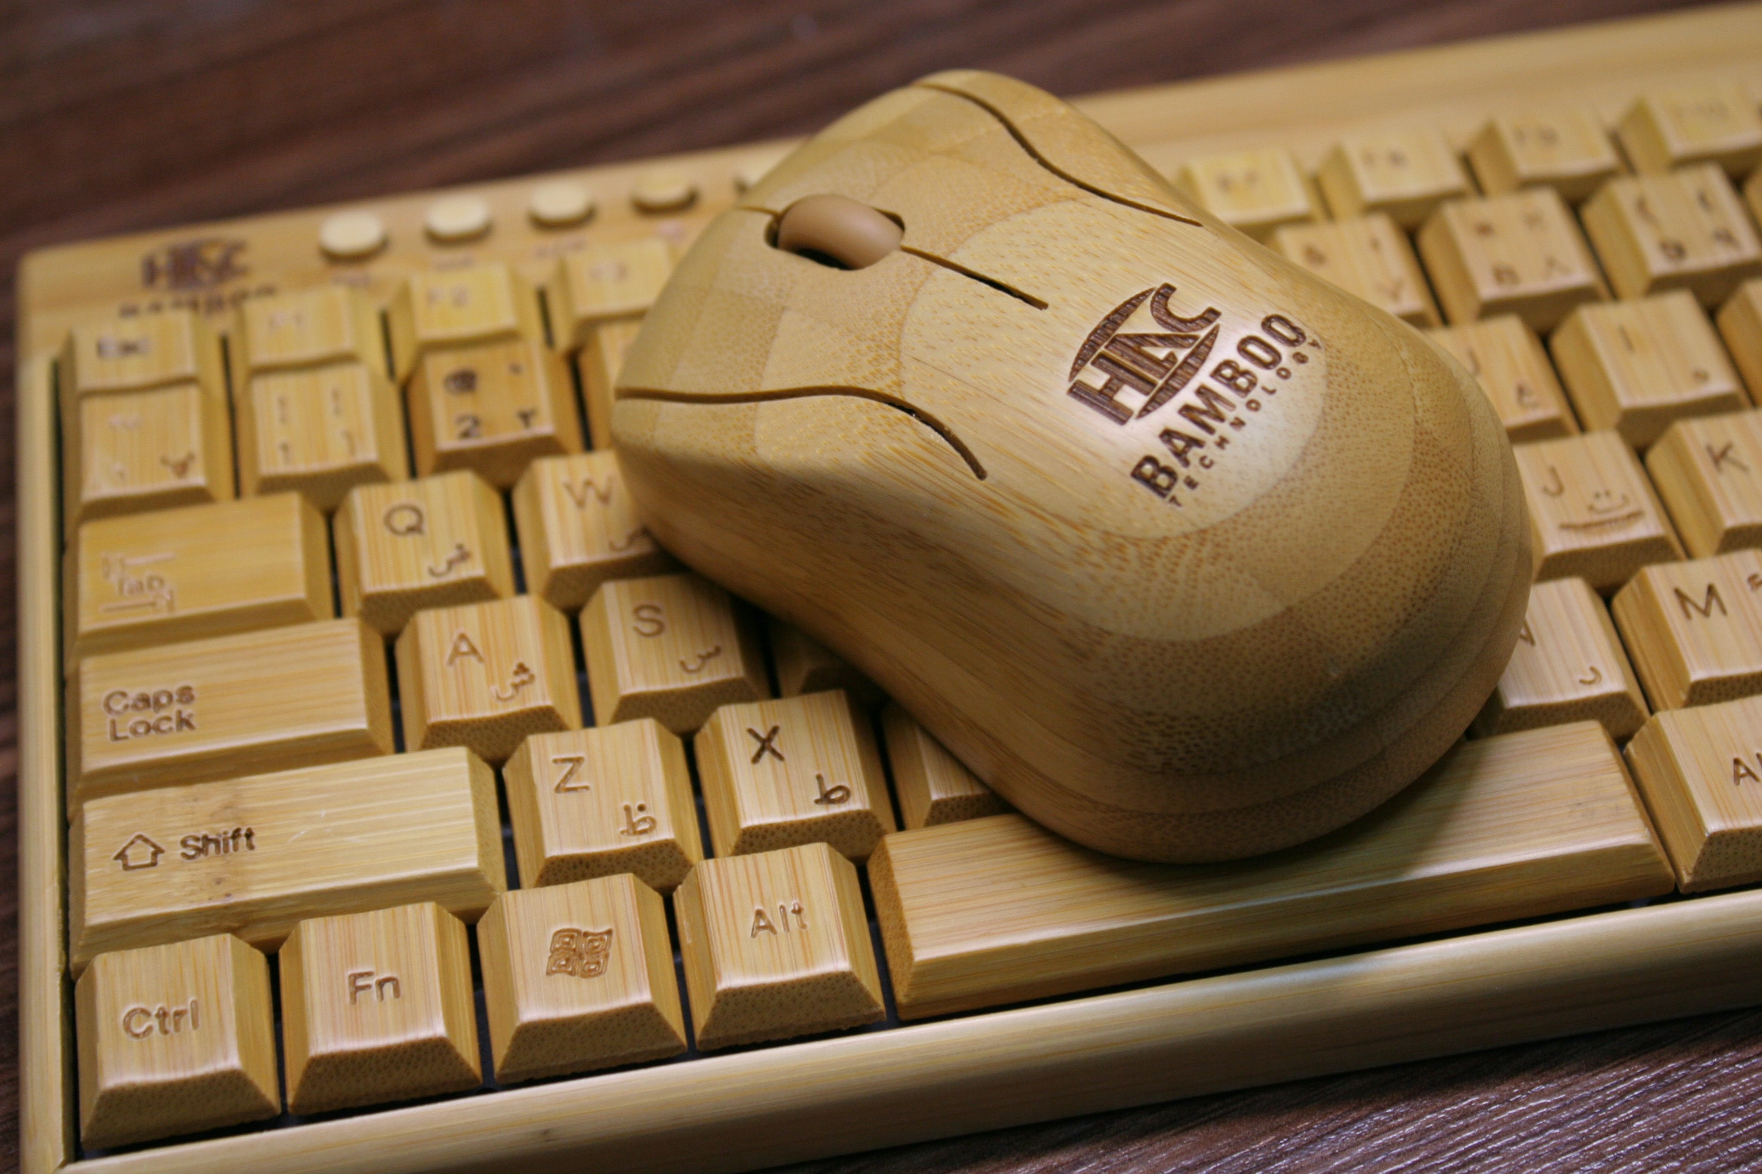
Mouse & Keyboard
OpenCV
Mediapipe
PyAutoGUI
Camera image
Hand recognition
Control
Module

Slide 10



PyAutoGUI
Operating System
Mouse & Keyboard
Gesture Recognition
modes
Deque
AI Model
Data Collection
OpenCV
GUI Monitor
`
Run
Run
Run
Mediapipe

Slide 11
Operating System
Mouse & Keyboard
Gesture Recognition
modes
Deque
AI Model
Data Collection
OpenCV
GUI Monitor
`
Run
Run
Run
Mediapipe

Slide 12






Framework
Data Collection
AI Model
Gesture Recognition
Operating System
GUI Monitor
Notes:
準確度高不一定代表姿勢判斷正確

Slide 13

Data Collection
AI Model
Gesture Recognition
Operating System
GUI Monitor
Notes:
相對座標概念

Slide 14
Data Collection
21 key point coordinates
AI Model
Gesture Recognition
Operating System
GUI Monitor
Notes:
相對座標概念

Slide 15
Data Collection
Absolute coordinates
ID:4 (575,500)
ID:20 (500,550)
Wrist (550,450)
AI Model
Gesture Recognition
Operating System
GUI Monitor
Notes:
相對座標概念

Slide 16
Data Collection
Relative coordinates
ID:4 (25,50)
ID:20 (-50,100)
Wrist (0, 0)
Ensure same gesture recognition can be placed in any position
AI Model
Gesture Recognition
Operating System
GUI Monitor
Notes:
相對座標概念

Slide 17
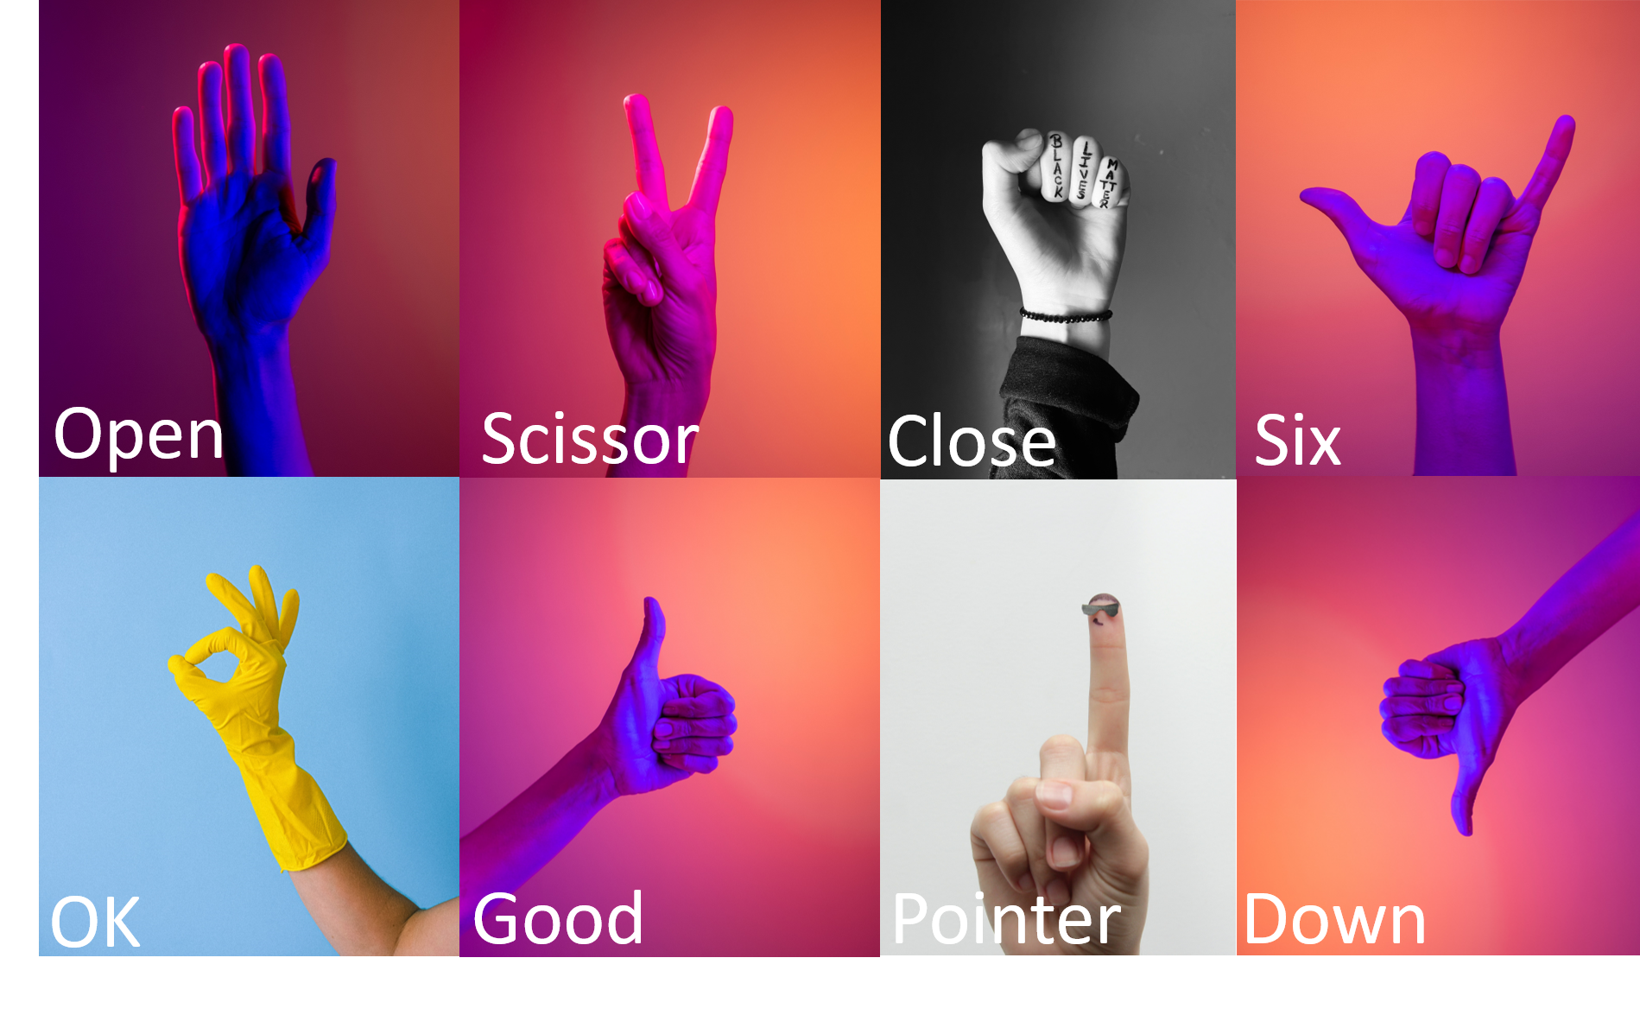
Data Collection
Static Gesture
AI Model
Gesture Recognition
Operating System
GUI Monitor
Notes:
還有None

Slide 18


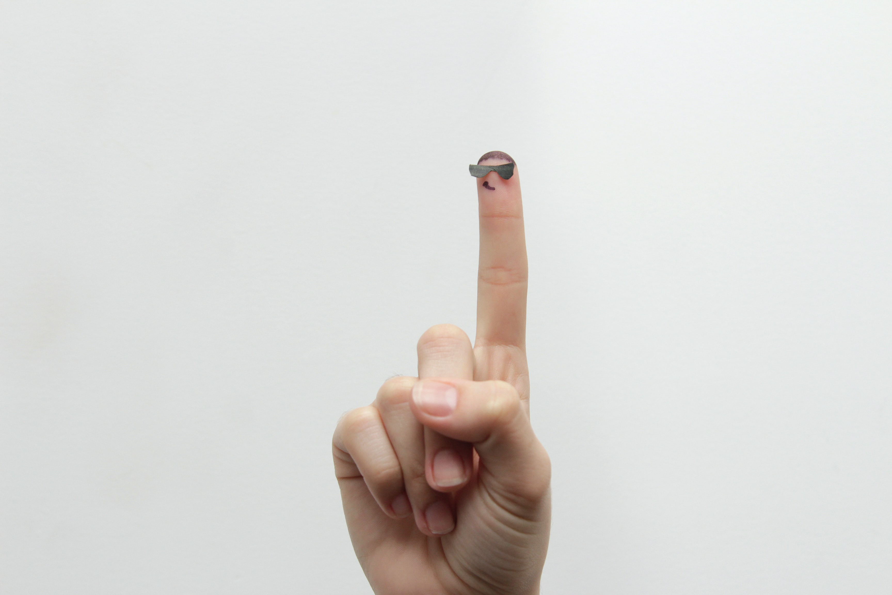
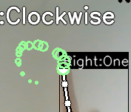
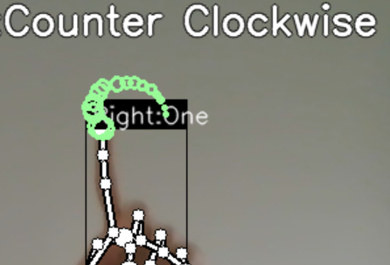

Data Collection
Dynamic Gesture
[550, 165]
Clockwise Spin
Counterclockwise Spin
Moving
AI Model
Gesture Recognition
Operating System
GUI Monitor
Notes:
在電腦眼裡的樣子

Slide 19
Data Collection
Clockwise Spin
(16 timesteps)
T-15
T-14
T-13
…
T-02
T-01
T
[526, 176]
[509, 188]
…
[644, 219]
[644, 196]
[642, 178]
[550, 165]
Convert to relative coordinates from T-15
T-15
T-14
T-13
…
T-02
T-01
T
[0, 0]
[-24, 11]
[-41, 23]
…
[94, 54]
[94, 31]
[92, 13]
Normalized to fit screen width and height
(X Divided by width and Y divided by height)
T-15
T-14
T-13
…
T-02
T-01
T
[0, 0]
[-0.025, 0.0204]
[-0.0427, 0.0426]
…
[0.0979, -0.1]
[0.0979, -0.0574]
[-0.0958, -0.024]
AI Model
Gesture Recognition
Operating System
GUI Monitor
Notes:
640 480

Slide 20
Operating System
Mouse & Keyboard
Gesture Recognition
modes
Deque
AI Model
Data Collection
GUI Monitor
`
Run
Run
Run

Slide 21
Operating System
Mouse & Keyboard
Gesture Recognition
modes
Deque
AI Model
Data Collection
GUI Monitor
`
Run
Run
Run

Slide 22


30000+ Training Data
AI Model
Gesture Recognition
Operating System
GUI Monitor
Data Collection
Static gesture model
Dynamic gesture model

Slide 23
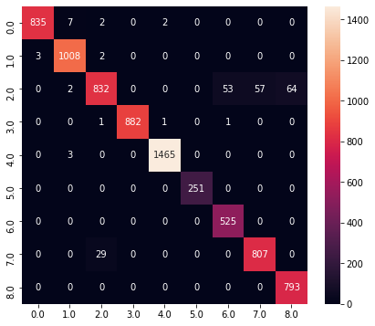
Confusion matrix
AI Model
Gesture Recognition
Operating System
GUI Monitor
Data Collection
Static gesture model
Dynamic gesture model

Slide 24
Accuracy: 97%
AI Model
Gesture Recognition
Operating System
GUI Monitor
Data Collection
Static gesture model
Dynamic gesture model
Notes:
Accuracy = f1 score average
兩個模型同時納入平均

Slide 25
5000+ Training Data
AI Model
Gesture Recognition
Operating System
GUI Monitor
Data Collection
Dynamic gesture model
Static gesture model

Slide 26
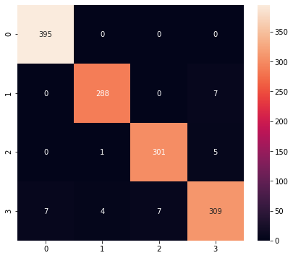
Confusion matrix
AI Model
Gesture Recognition
Operating System
GUI Monitor
Data Collection
Dynamic gesture model
Static gesture model

Slide 27
Accuracy: 98%
AI Model
Gesture Recognition
Operating System
GUI Monitor
Data Collection
Dynamic gesture model
Static gesture model

Slide 28
Operating System
Mouse & Keyboard
Gesture Recognition
modes
Deque
AI Model
Data Collection
GUI Monitor
`
Run
Run
Run

Slide 29
Operating System
Mouse & Keyboard
Gesture Recognition
modes
Deque
AI Model
Data Collection
GUI Monitor
`
Run
Run
Run

Slide 30
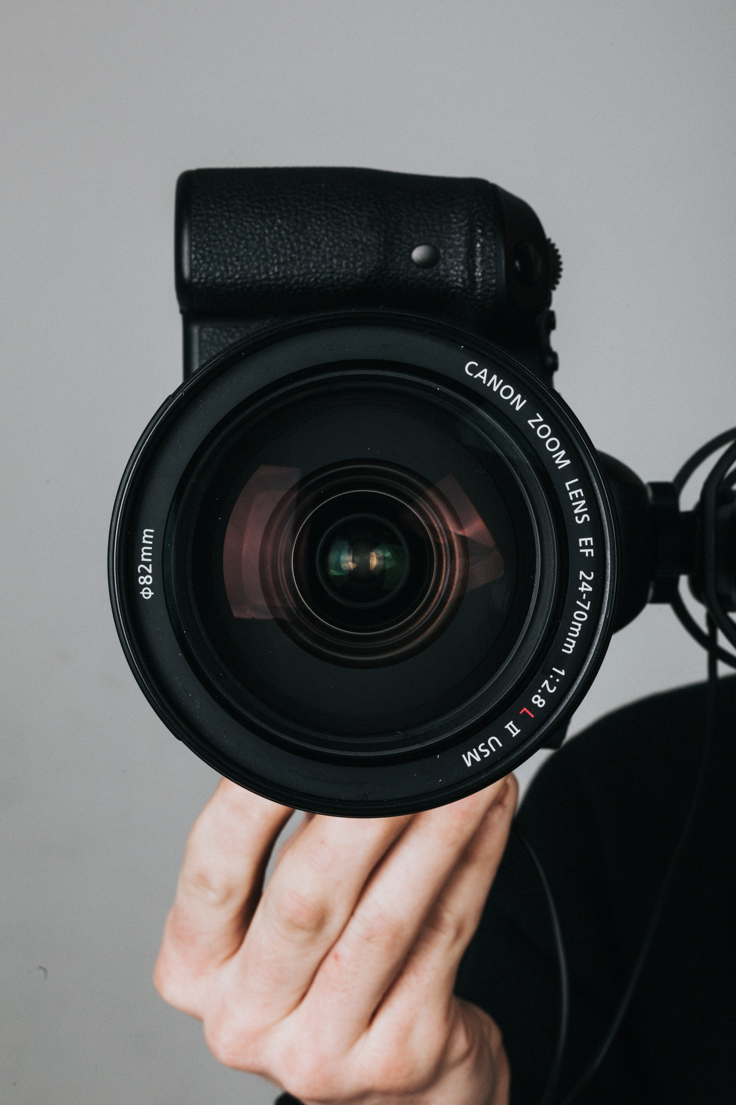
Gesture Recognition
How do they see you?
Operating System
GUI Monitor
Data Collection
AI Model

Slide 31


Gesture Recognition
Record all the images frame by frame
Operating System
GUI Monitor
Data Collection
AI Model
Notes:
opencv

Slide 32

Gesture Recognition
Detect your hand
Operating System
GUI Monitor
Data Collection
AI Model

Slide 33
Gesture Recognition
(-50, 50)
(50, 75)
(0, 0)
Analyze and digitize it
Operating System
GUI Monitor
Data Collection
AI Model

Slide 34
Gesture Recognition
ID:0
ID:1
ID:2
…
ID:20
(0, 0)
…
(-50, 50)
(50, 75)
…
(XX,YY)
Operating System
GUI Monitor
Data Collection
AI Model
Notes:
靜態資料儲存型態

Slide 35

Gesture Recognition
...
???????
???
#a3?hq
??????
Haa3%4
12412
$?
……
今天晚餐吃什麼?
??????
Open
Model
ID:0
…
ID:1
(0, 0)
ID:20
(-50, 50)
…
ID:2
(50, 75)
…
(XX,YY)
Operating System
GUI Monitor
Data Collection
AI Model

Slide 36
Gesture Recognition
Open
Open
Open
Model
ID:0
Open
Open
Operating System
GUI Monitor
Data Collection
AI Model

Slide 37
Gesture Recognition
Deque
0
1
2
3
4
Open
Open
Open
Open
Open
…
Operating System
GUI Monitor
Data Collection
AI Model
Notes:
記住這張圖

Slide 38
Operating System
Mouse & Keyboard
Gesture Recognition
modes
Deque
AI Model
Data Collection
GUI Monitor
`
Run
Run
Run

Slide 39
Operating System
Mouse & Keyboard
Gesture Recognition
modes
Deque
AI Model
Data Collection
GUI Monitor
`
Run
Run
Run

Slide 40
Operating System
Mouse & Keyboard
Gesture Recognition
modes
Deque
AI Model
Data Collection
Static
Dynamic
GUI Monitor
`
Run
Run
Run

Slide 41
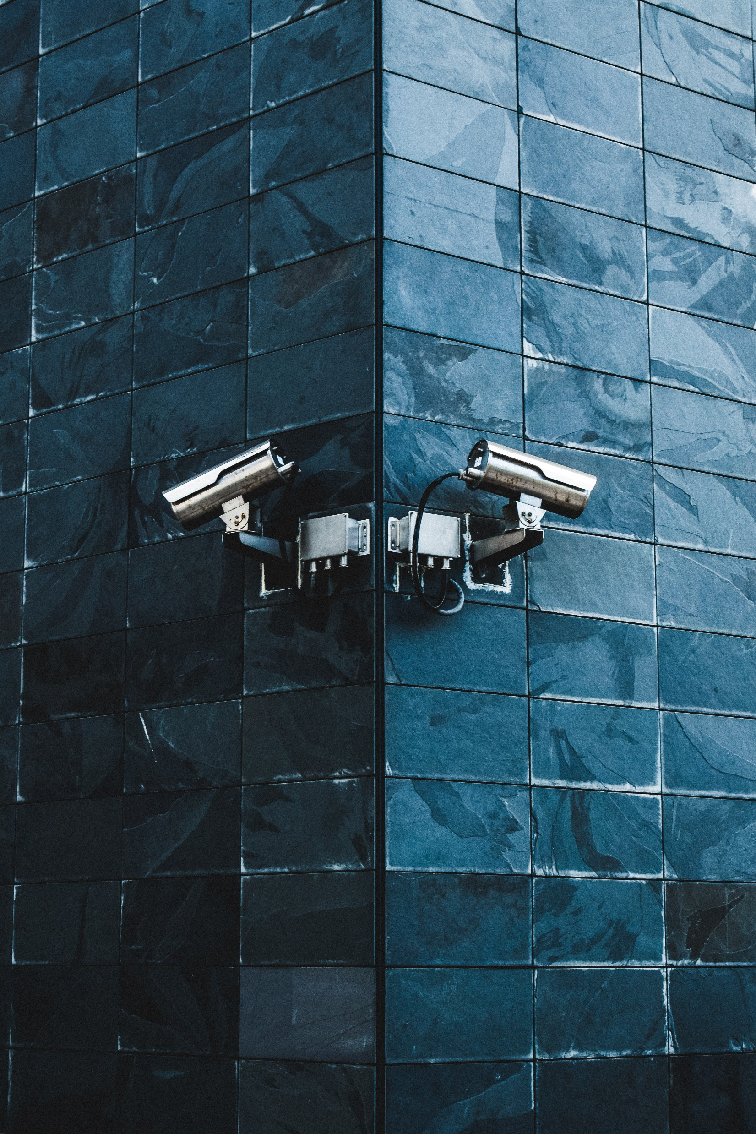
Gesture Recognition
Static
Dynamic
Operating System
GUI Monitor
Data Collection
AI Model

Slide 42
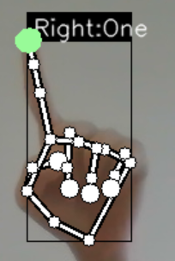
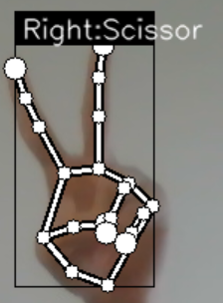
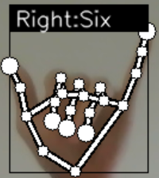
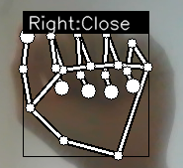
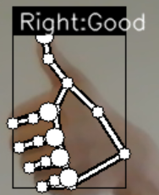
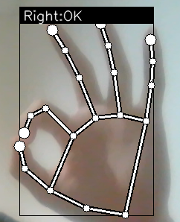
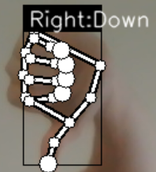
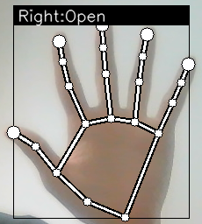
Static
Dynamic
Gesture Recognition
DNN Model
LSTM Model
None is all included
Operating System
GUI Monitor
Data Collection
AI Model

Slide 43

AI Model
AI Models
DNN Model1
Deque1
0 | 1 | 2 | 3 | 4 | …
One | One | One | One | One | …
One
ID:0
ID:1
ID:2
…
ID:20
(0, 0)
…
(-50, 50)
(50, 75)
…
(XX,YY)
…
…
LSTM Model
(timestep=16)
T-15
T-14
T-13
…
T
Stop
Deque3
0 | 1 | 2 | 3 | 4
Stop | Stop | Stop | Stop | Stop
(0, 0)
…
(-50, 50)
(50, 75)
…
(XX,YY)
ID:8 (16 timesteps)
Notes:
在電腦眼裡的樣子

Slide 44
AI Model
AI Models
Deque1
0 | 1 | 2 | 3 | 4 | …
One | One | One | One | One | …
DNN Model1
One
ID:0
ID:1
ID:2
…
ID:20
(0, 0)
…
(-50, 50)
(50, 75)
…
(XX,YY)
…
…
LSTM Model
(timestep=16)
T-15
T-14
T-13
…
T
Stop
Deque3
0 | 1 | 2 | 3 | 4
Stop | Stop | Stop | Stop | Stop
(0, 0)
…
(-50, 50)
(50, 75)
…
(XX,YY)
ID:8 (16 timesteps)
Notes:
在電腦眼裡的樣子

Slide 45
Operating System
Mouse & Keyboard
Gesture Recognition
modes
Deque
AI Model
Data Collection
GUI Monitor
`
Run
Run
Run

Slide 46
Operating System
Mouse & Keyboard
Gesture Recognition
modes
Deque
AI Model
Data Collection
GUI Monitor
`
Run
Run
Run

Slide 47
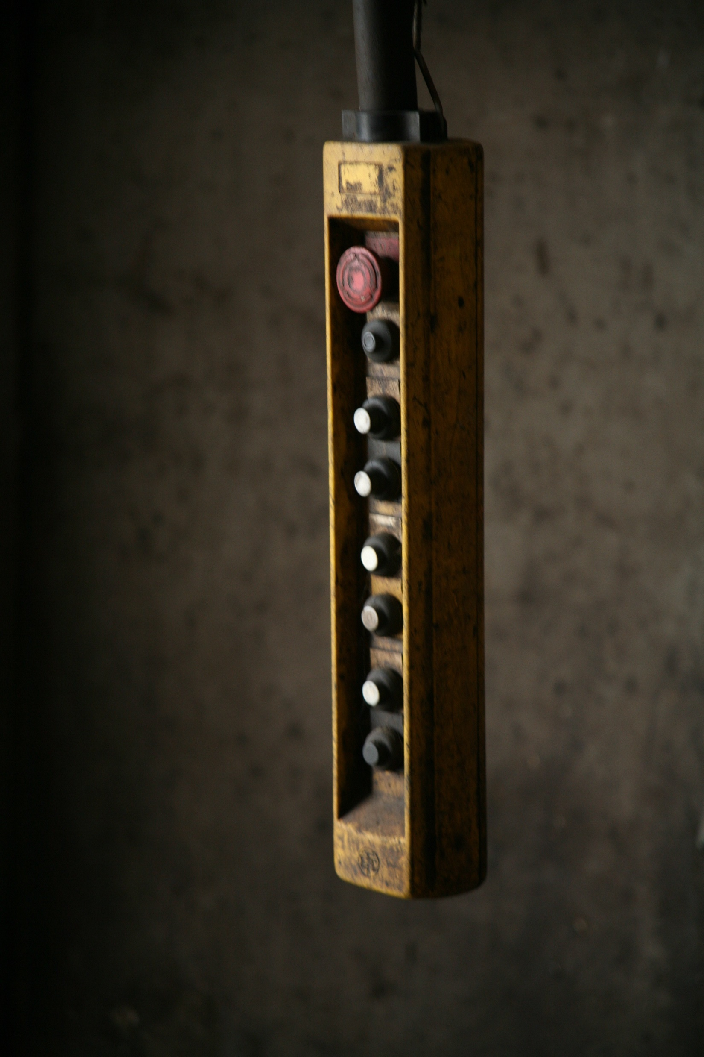
Close
Operating System
Gesture Recognition
Deque
AI Model
(Stabilize our system)
Data Collection
0
1
2
3
4
Open
Open
Open
Open
Open
…
GUI Monitor

Slide 48
OK
Operating System
Gesture Recognition
Deque
AI Model
Data Collection
0
1
2
3
4
Open
Open
Open
Open
Open
Close
…
GUI Monitor

Slide 49
Operating System
Gesture Recognition
Deque
AI Model
Data Collection
0
1
2
3
4
Open
Open
Open
Open
Close
OK
…
GUI Monitor

Slide 50




Six
Six
Six
Six
Six
Operating System
Gesture Recognition
0
1
2
3
4
Open
Open
Open
Close
OK
…
AI Model
0
1
2
3
4
Open
Open
Open
Close
OK
…
0
1
2
3
4
Data Collection
Open
Open
Open
Close
OK
…
0
1
2
3
4
Open
Open
Open
Close
OK
…
GUI Monitor

Slide 51
Six
Six
Six
Six
Six
Six
Operating System
Gesture Recognition
0
1
2
3
4
Open
Open
Open
Close
OK
Six
…
AI Model
0
1
2
3
4
Open
Open
Open
Close
OK
Six
…
0
1
2
3
4
Data Collection
Open
Open
Open
Close
OK
Six
…
0
1
2
3
4
Open
Open
Open
Close
OK
Six
…
GUI Monitor

Slide 52
Six
Six
Six
Six
Six
Six
Six
Six
Operating System
Gesture Recognition
0
1
2
3
4
Open
Open
Close
OK
Six
Six
…
AI Model
0
1
2
3
4
Open
Open
Close
OK
Six
Six
…
0
1
2
3
4
Data Collection
Open
Open
Close
OK
Six
Six
…
0
1
2
3
4
Open
Open
Close
OK
Six
Six
…
GUI Monitor

Slide 53
Six
Six
Six
Six
Six
Six
Six
Six
Operating System
Gesture Recognition
0
1
2
3
4
Six
Six
Six
Six
Six
…
AI Model
0
1
2
3
4
Six
Six
Six
Six
Six
…
0
1
2
3
4
Data Collection
Six
Six
Six
Six
Six
…
0
1
2
3
4
Six
Six
Six
Six
Six
…
GUI Monitor

Slide 54
Operating System
Gesture Recognition
0
1
2
3
4
Six
Six
Six
Six
Six
…
AI Model
0
1
2
3
4
Six
Six
Six
Six
Six
…
0
1
2
3
4
Data Collection
Six
Six
Six
Six
Six
…
0
1
2
...
37
38
39
Six
Six
Six
…
Six
Six
Six
…
GUI Monitor
Notes:
舉例來說->不常使用模式切換->加長deque = 增加條件

Slide 55
Operating System
Gesture Recognition
AI Model
Data Collection
0
1
2
...
37
38
39
Six
Six
Six
…
Six
Six
Six
…
GUI Monitor

Slide 56
Operating System
Gesture Recognition
AI Model
0
1
2
...
37
38
39
Six
Six
Six
…
Six
Six
Six
…
Data Collection
Function: Changing
Mode
GUI Monitor

Slide 57
Operating System
Mouse & Keyboard
Gesture Recognition
modes
Deque
AI Model
Data Collection
GUI Monitor
`
Run
Run
Run

Slide 58
PyAutoGUI
Operating System
Mouse & Keyboard
Gesture Recognition
modes
Deque
AI Model
Data Collection
GUI Monitor
`
Run
Run
Run

Slide 59
Operating System
Gesture Recognition
Mode
AI Model
Sleep
Mouse
Keyboard
Data Collection
GUI Monitor
With a different mode, same gesture might have different function

Slide 60
Operating System
Gesture Recognition
Sleep
Mode
AI Model
Web Cam
Image
NN Model
Deque 1
LSTM Model
Deque 2
Data Collection
GUI Monitor

Slide 61
Operating System
Gesture Recognition
Sleep
Mode
AI Model
Deque 1
Do nothing
No
Is label six?
Data Collection
Yes
Change mode
Sleep mode (auto turn on in 10 sec)
GUI Monitor

Slide 62
Operating System
Gesture Recognition
Sleep
Mode
AI Model
Change mode
Data Collection
GUI Monitor

Slide 63

Operating System
Gesture Recognition
Mouse
Mode
AI Model
Web Cam
Image
NN Model
Deque 1
LSTM Model
Deque 2
Data Collection
GUI Monitor

Slide 64
Operating System
Gesture Recognition
Mouse
Mode
Deque 1
Deque 2
AI Model
Which label
Which label
Data Collection
Good
Down
OK
Close
Six
Scissor
One
Scroll up
Scroll down
Last page
DoubleClick
Change mode
Click
Control mouse
GUI Monitor

Slide 65
Operating System
Gesture Recognition
Mouse
Mode
Double
click
Control mouse
AI Model
Last page
Click
Data Collection
Scroll down
Change mode
GUI Monitor
Scroll up

Slide 66
Operating System
Gesture Recognition
Keyboard
Mode
AI Model
NN Model1
Deque 1
Web Cam
Image
NN Model2
Deque 2
Data Collection
LSTM Model
Deque 3
GUI Monitor

Slide 67
Operating System
Gesture Recognition
Keyboard
Mode
Deque 1
Deque 2
AI Model
Which label
Which label
Data Collection
Six
Close
Counter clockwise
Scissor
Good
Ok
Open
Down
Clockwise
Change mode
Play/ Pause
Volume up
Subtitle
forward
5 s
backward 5 s
Volume down
Speed down
Control mouse
GUI Monitor

Slide 68
Operating System
Gesture Recognition
Keyboard
Mode
Forward 5s
Speed up
AI Model
Speed down
Play/ Pause
Data Collection
Volume down
Change mode
GUI Monitor
Volume up
Backward 5s

Slide 69
Operating System
Mouse & Keyboard
Gesture Recognition
modes
Deque
AI Model
Data Collection
GUI Monitor
`
Run
Run
Run

Slide 70
Operating System
Mouse & Keyboard
Gesture Recognition
modes
Deque
AI Model
Data Collection
GUI Monitor
`
Run
Run
Run

Slide 71

GUI Monitor
Run
Mouse Mode
`
Run
Keyboard Mode
Run
Sleep Mode
Data Collection
AI Model
Gesture Recognition
Operating System

Slide 72




Run
Mouse Mode
`
Display
Run
Keyboard Mode
Run
Sleep Mode

Slide 73
Mouse Mode
Run

Slide 74

Mouse Mode
Run

Slide 75
Mouse Mode
Run

Slide 76

Mouse Mode
Run

Slide 78

Reference
Mediapipe
https://github.com/kinivi/hand-gesture-recognition-mediapipe
https://www.youtube.com/watch?v=8gPONnGIPgw&t=1493s
Gesture Reference
https://www.youtube.com/watch?v=k38ygfiAqVg
Operating System
https://www.computervision.zone/courses/ai-virtual-mouse/
https://yanwei-liu.medium.com/pyautogui-%E4%BD%BF%E7%94%A8python%E6%93%8D%E6%8E%A7%E9%9B%BB%E8%85%A6-662cc3b18b80
GUI
https://www.cnblogs.com/linyfeng/p/12239856.html
https://pyautogui.readthedocs.io/en/latest/keyboard.html#keyboard-keys

Slide 79
Like us!
Github
zaqxsw800402/all_you_need (github.com)
Display Video
https://youtu.be/z6rNsWVWXQo

